Slide 1
Week 7 Sessions 8
10/10/2025

Slide 2

Recursion
Recursion: The definition of an operation in terms of itself.
Solving a problem using recursion depends on solving smaller occurrences of the same problem.
Recursive programming: Writing methods that call themselves to solve problems recursively.
An equally powerful substitute for iteration (loops)
Particularly well suited to solving certain types of problems

Slide 3
Why learn Recursion?
“Cultural experience” – A different way of thinking of problems.
Can solve some kinds of problems better iteration.
Leads to elegant, simplistic, short code (When used well).
Many programming languages (“functional languages such as Scheme, ML, and Haskell) use recursion exclusively (no loops).
A key component of the rest of the assignments in CPS181.
(Because we’ll be working with data structures)

Slide 4
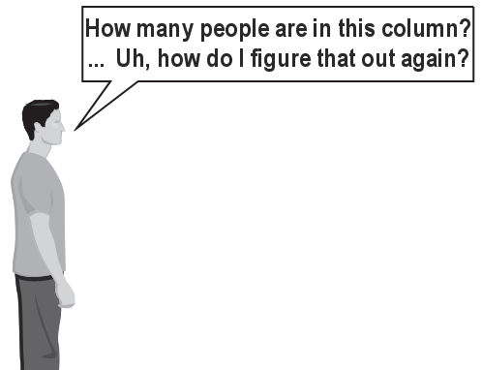

Exercise
(To a student In the front row)
How many students total are directly behind you in your “column” of the classroom?
You have poor vision, so you can only see the people right next to you. So you can’t just look back and count.
BUTTT you are allowed to ask questions of the person next to you.
How can we solve this problem?
(Recursively)

Slide 5
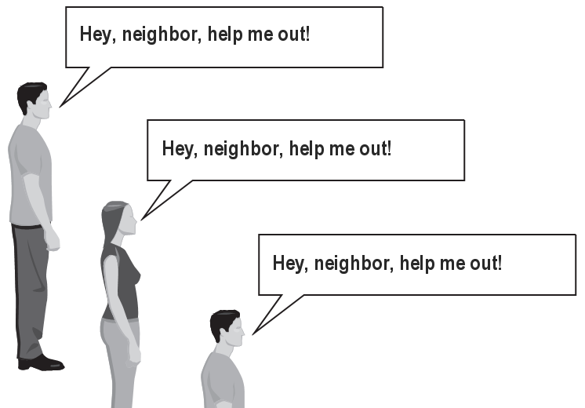
The idea
Recursion is all about breaking a big problem into smaller occurrences of that same problem.
Each person can solve a small part of the problem.
What is a small version of the problem that would be easy to answer?
What information from a neighbor might help me?

Slide 6
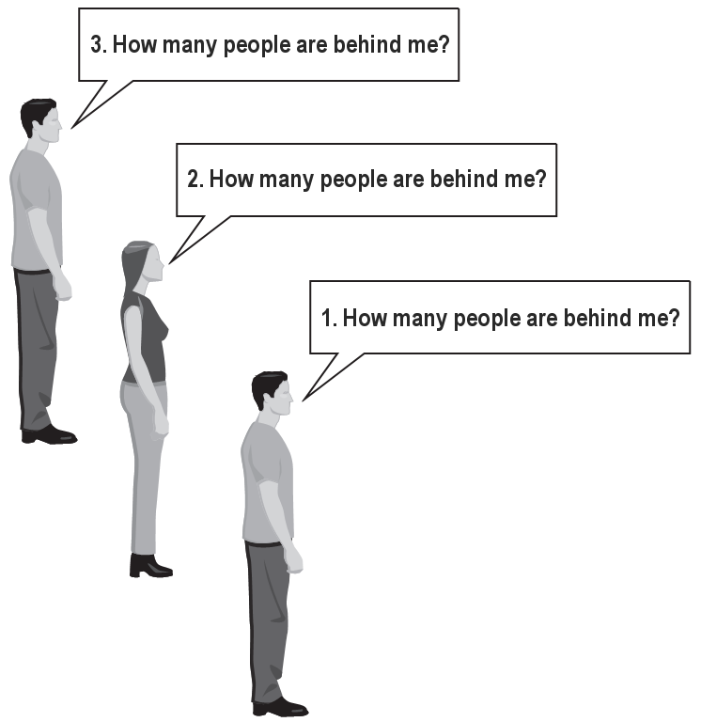
Recursive algorithm
Number of people behind me:
If there is someone behind me,
Ask him/her how many people are behind him/her.
When they respond with a value N, then I will answer N + 1.
If there is nobody behind me, I will answer 0.

Slide 7
Recursion and cases
Every recursive algorithm involves at least 2 cases:
Base case: A simple occurrence that can be answered directly.
Recursive case: A more complex occurrence of the problem that cannot be directly answered. But, can instead be described in terms of smaller occurrences of the same problem.
Some recursive algorithms have more than one base or recursive case, but all have at least one of each.
A crucial part of recursive programming is identifying these cases.

Slide 8
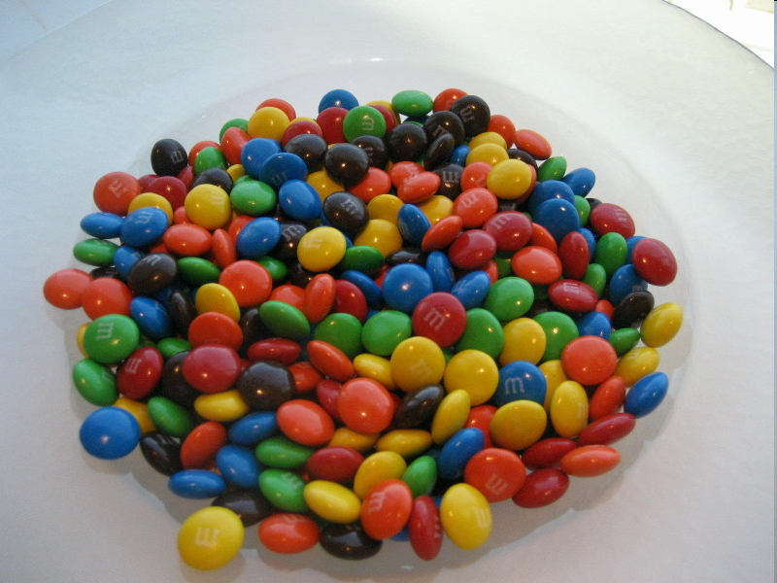
Another recursive task
How can we remove exactly half of the M&M’s in a large bowl, without dumping them all out or being able to count them?
What if multiple people help with solving the problem?
Can each person do a small part of the work?
What is a number of M&M’s that it is easy to double, even if you can’t count?
(What is a “base case”?)

Slide 9
Recursion in java
Consider the following method to print a line of * characters:
// Prints a line containing the given number of stars.
// Precondition: n >= 0
public static void printStars(int n) {
for (int i = 0; i < n; i++) {
System.out.print("*");
}
System.out.println(); // end the line of output
}
Write a recursive version of this method (that calls itself).
Solve the problem **WITHOUT USING ANY LOOPS**
Hint: Your solution should print just one star at a time.

Slide 10
A basic case
What are the cases to consider?
What is a very easy number of stars to print without a loop?
public static void printStars(int n) {
if (n == 1) {
// base case; just print one star
System.out.println("*");
} else {
...
}
}

Slide 11
Handling more cases
Handling additional cases, with no loops (in a bad way):
public static void printStars(int n) {
if (n == 1) {
// base case; just print one star
System.out.println("*");
} else if (n == 2) {
System.out.print("*");
System.out.println("*");
} else if (n == 3) {
System.out.print("*");
System.out.print("*");
System.out.println("*");
} else if (n == 4) {
System.out.print("*");
System.out.print("*");
System.out.print("*");
System.out.println("*");
} else ...
}

Slide 12
Using recursion properly
Condensing the recursive cases into a single case:
public static void printStars(int n) {
if (n == 1) {
// base case; just print one star
System.out.println("*");
} else {
// recursive case; print one more star
System.out.print("*");
printStars(n - 1);
}
}

Slide 13
Recursive tracing
Consider the following recursive method:
public static int mystery(int n) {
if (n < 10) {
return n;
} else {
int a = n / 10;
int b = n % 10;
return mystery(a + b);
}
}
What is the result of the following call?
Mystery(648)

Slide 14
A recursive trace
mystery(648):
int a = 648 / 10; // 64
int b = 648 % 10; // 8
return mystery(a + b); // mystery(72)
mystery(72):
int a = 72 / 10; // 7
int b = 72 % 10; // 2
return mystery(a + b); // mystery(9)
mystery(9):
return 9;

Slide 15
Recursive tracing 2
Consider the following recursive method:
public static int mystery(int n) {
if (n < 10) {
return (10 * n) + n;
} else {
int a = mystery(n / 10);
int b = mystery(n % 10);
return (100 * a) + b;
}
}
What is the result of the following call?
mystery(348)

Slide 16
A recursive trace 2
mystery(348)
int a = mystery(34);
int a = mystery(3);
return (10 * 3) + 3; // 33
int b = mystery(4);
return (10 * 4) + 4; // 44
return (100 * 33) + 44; // 3344
int b = mystery(8);
return (10 * 8) + 8; // 88
return (100 * 3344) + 88; // 334488
What is this method really doing?

Slide 17
Week 8 Sessions 9
10/15/2025

Slide 18
1. Exception Handling
Exception handling enables programs to handle some of the exceptional situations and continue with normal execution.
Exceptions are thrown from methods. The calling methods can:
Catch and handle exceptions, or
Re-throw exceptions
If a thrown exception is re-thrown all the way up to the Java virtual machine, or ignored (not all exception types can be ignored) then the program crashes.
Exceptions are not replacements for testing and data validation. They should only be used if the method cannot/should not decide how a given exceptional situation should be handled.

Slide 19
Examples:
Scenario #1: We try to remove an item from a linked list. The remove method determines that the item is not on the list.
Question: Should the method throw an exception?
Scenario #2: We are evaluating postfix expressions. The method takes a String object containing a postfix expression as a parameter. It parses the input string and evaluates the expression. During evaluation, the method determines that there are two fee operations in the input string.
Question: Should the method throw an exception?

Slide 20
Example Answers
Scenario 1: No, the method should not throw an exception.
Reasoning: The method's goal is to remove the item. If the item isn't present, the goal has been met by doing nothing, and the list remains in a valid state. This is an expected outcome for a search-and-modify operation, not an exceptional error. The method should typically return a boolean (false) to indicate failure to remove, or perhaps the item itself (null) if it were designed to return the removed object.
Scenario 2: Yes, the method should throw an exception.
Reasoning: The input string is structurally invalid as a postfix expression (it violates the basic rule of having enough operators for the operands). Since the method cannot produce a meaningful or correct numerical result, this constitutes an unrecoverable error due to bad input. Throwing an exception (like an IllegalArgumentException) is the clearest way to signal that the method's contract was violated by the caller.

Slide 21
2. Exception Types in Java
As everything else in Java, exceptions are classes. Java provides a very large set of different exception classes to indicate different possible problems. We can use any of these exception classes in your own program.

Slide 22
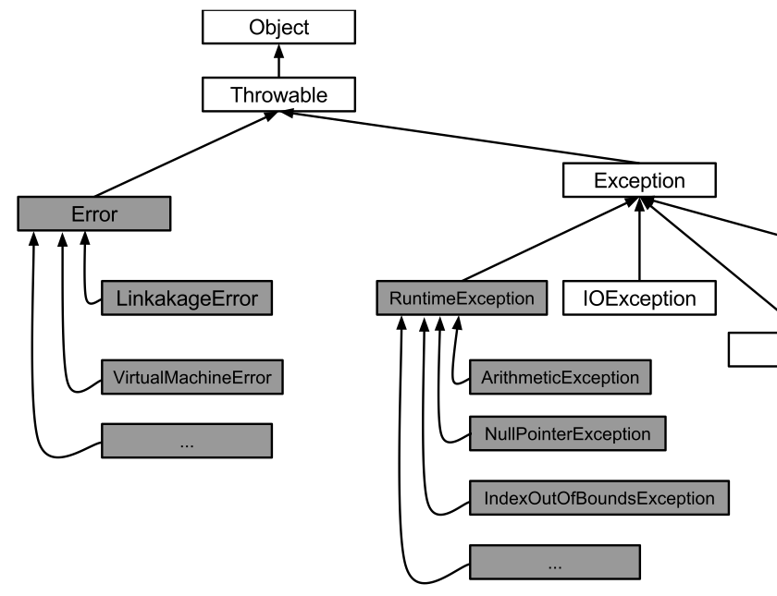
2. Exception types in java
All Java exception classes are instances of Throwable (think things that can be thrown).
Throwable is further subdivided into Error and
Exception classes.

Slide 23
2.1. Error Subclass of throwable
Error class represents errors that normal applications should not even try to handle. They indicate serious problems from which an application cannot recover.
Example: LinkageError indicates that the program depends on some other class that has changed since the last compilation of the application and is no longer compatible with the current application.
Example: VirtualMachineError class indicates that the Java Virtual Machine is bro- ken or has run out of resources necessary for it to continue operating (there is absolutely nothing that our program can do about it).

Slide 24
2.2 Exception Subclass of throwable
Exception class represents errors that applications can try to handle (not all of those errors can be recovered from though). When we write our own exception classes they are subclasses of the Exception class. We see these exceptions whenever the program crashes (due to bugs or user errors).

Slide 25
2.2.1. Unchecked exceptions –Runtime errors
One of the big subclasses of Exception class is the class RuntimeErrors. RuntimeErrors are the only class of exceptions that our programs are allowed to ignore. They are, unfortunately, so abundant, that it would be almost impossible to try to catch and handle these. They are referred to as unchecked exceptions - the compiler does not make sure that you check for those (because the compiler does not know when they can occur either).
The RuntimeErrors that we see most often are
ArithmeticException (try to divide by zero),
NullPointerException (well, we all know how often that one comes out of nowhere),
IndexOutOfBoundsException (try to access an array location that does not exist).

Slide 26
2.2.2 Checked exceptions
Any other subclass of the Exception class has to be handled. Our code has to either catch it and handle it, or, declare that our method might throw one of those exceptions.

Slide 27
3 Exception handling – syntax
When a program is running the exception can be thrown either by other parts of the program or by some of the methods from Java provided classes. In either way, catching exceptions works the same.
In order to catch an exception, we need to surround the code that might potentially cause an exception by a try ... catch ... block.

Slide 28
3.1 Catching Exceptions
try {
// A - code before exception might occur
// B - code in which an exception might be thrown
// C - code after the exception might be thrown }
catch (ExceptionType1 ex ) {
// handle an exception of type Exception1 }
catch (ExceptionType2 ex ) {
// handle an exception of type Exception2 } ...
catch (Exception ex ) {
// handle an exception of type Exception }
finally {
// code that is executed regardless of what exceptions were
// thrown and caught
// (usually used to handle finalizing of I/O operations
// so that files are closed correctly and do not get corrupted) }

Slide 29
3.1 catching Exceptions cont.
The try{ ... } block is divided into three parts: A, B and C. Part A always executes. If an exception occurs during execution of part B, the rest of the try{ ... (i.e., part C) is skipped and the execution continues into the catch{ ... } block } blocks.
The first catch{ ... } block that matches the type of exception thrown is entered. Remember that any subclass exception type matches its superclass exception class. Only one of the catch{ ... } catch blocks is ever executed.
Each try{…} block has to be followed by at least one catch{ … } block or finally{ … } block.

Slide 30
3.2 throwing exceptions
In order to throw an exception, we need to create an exception object to be thrown. That object can carry information to the calling method about what problem occurred when the exception was thrown.
returnType methodName ( ... ) throws ExceptionType { ...
if (error occurs)
throw new ExceptionType ( message to the calling method );
}
The keyword throws followed by the exception type is mandatory for checked exception types (it is not used if the method throws unchecked exception).
Notice that there are two different keywords: throws and throw. The first one is just declaration indicating the type of exception that the method might throw. The second one performs the actual action of throwing the error. If the method throws more than one type of exception the keyword throws should be followed by a comma-separated list of exception types.

Slide 31
4 getting information from exceptions
The exception objects are like little messengers carrying the bad news from the method that throws them to the method that catches them. Those messages can be used to determine what went wrong. We will often make use of the following methods that are inherited by all exception classes from the Throwable class:
getMessage() returns the message that was passed to the constructor when the exception object was created
toString() returns the full name of the exception concatenated with the message re- turned by the getMessage() call
printStackTrace() prints the stack trace on the console WARNING: if our exception handler does only that, then effectively we are not handling the exception - that’s what JVM would have done

